Slide 1
The OpenVAF Verilog-A Compiler
for the OpenPDK Ecosystem
Árpád Bűrmen
Faculty of Electrical Engineering
University of Ljubljana, Slovenia
arpad.buermen@fe.uni-lj.si

Slide 2
IHP OpenPDK
https://github.com/IHP-GmbH/IHP-Open-PDK
SG13G2 process node - 130nm BiCMOS.
Ngspice devices:
  VBIC bipolar transistor model (1.15).
Verilog-A devices:
  PSP MOSFET model (103.6),
  r3_cmc resistor model,
  MOS varactor.
PDK designed to be used with the Ngspice simulator.
OpenVAF provides Verilog-A support in Ngspice.

Slide 3
The big picture
Circuit netlist
.subckt inv (in out vdd vss)
M1 (out in vss vss) nm w=10u l=1u
M2 (out in vdd vdd) pm w=15u l=1u
.ends
Analog device models (PDK)
.model nm nmos kp=1m vto=1.5 lambda=1m
.model pm pmos kp=0.6m vto=1.4 lambda=1.2m
Simulator
Compact models
(statically linked or dll)
Device equations are coded in Verilog-A.

Slide 4
Compact models - history
Yesterday – implemented in C using SPICE3 API.
Today – implemented in Verilog-A.
Need a compiler.
Verilog-A → dynamic library → loaded by simulator
ADMS (old) or OpenVAF (new).
ADMS (Xyce, Ngspice), OpenVAF (Ngspice, VACASK).
2001
2005
2020
2000-
BSIM3 v3.2.4
BSIM4 v4.5.9
BSIM4 v4.8.2
BSIM-BULK 107.1.0
PSP
SPICE3 API, C
Verilog-A

Slide 5
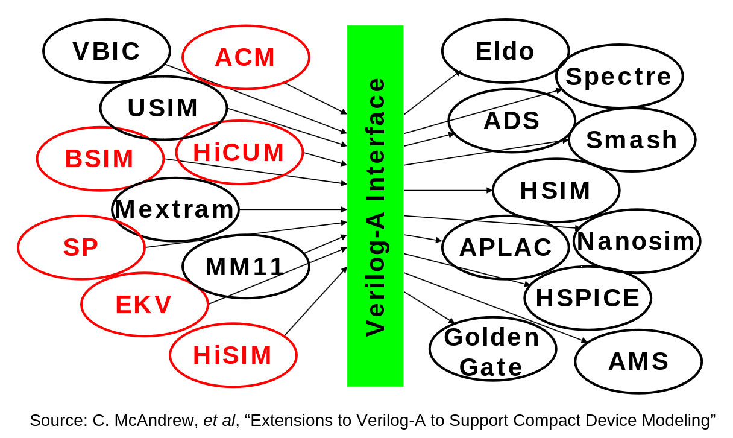
Main advantages of Verilog-A
Write Verilog-A once, deploy to multiple simulators.
Implement analysis once for all Verilog-A models.

Slide 6
Introduction to OpenVAF-reloaded
Verilog-A compiler for compact models.
Author: Pascal Kuthe, now works for Keysight.
https://github.com/arpadbuermen/OpenVAF
bleeding edge
https://github.com/OpenVAF/OpenVAF-Reloaded
community, lags behind
https://github.com/pascalkuthe/OpenVAF
dead, still active discussions
Compiles all CMC models without manual intervention.
Fast compilation, fast models.
Written in Rust, uses LLVM library to create an object file.
Extended OSDI API for using/accessing the compiled model (0.4).

Slide 7
OpenVAF internals
Verilog-A (.va)
MIR (high level SSA form)
SSA = Static Single Assignment
Lexer
MIR lowering
Token sequence
LLVM IR (low level SSA form)
Parser
MIR lowering
LLVM library
Abstract syntax tree (AST)
Object file
AST annotator
Linker
Annotated AST (HIR)
HIR lowering
Dynamic library (.osdi) exposing the OSDI API

Slide 8
OpenVAF-reloaded – what is new
Incorrect $analysis() reporting
$discontinuity(-1)
Incorrect handling of voltage
contrib when $mfactor!=1
A bunch of preprocessor bugs
Empty module not working
ceil() support
$limit with one argument
Singular matrix for
single node voltage contrib
String parameter ranges
PSP model derivatives issue
Preprocessed files now compile
$mfactor handling for voltage noise contributions
Singular Jacobian for voltage noise contribution nodes
Noise scaling with $mfactor
Crash in LLVM under Windows
List of model inputs
Jacobian entries output
Support for HB analysis
$fatal, $finish, $stop support
Dumping MIR, LLVM IR, DAE

Slide 9

OpenVAF-reloaded roadmap
Improve HB interface.
Interface for transient noise.
Attribute access (module, parameter).
HIR reverse engineering.
Timestep control ($bound_step).
Discontinuity signaling ($discontinuity).
Improve $simparam.
Speed improvements (inlining?).
Speed improvements (better IR?).
Document code as you go.

Slide 10

Ngspice
SPICE3-based circuit simulator.
Old, but definitely not obsolete.
OpenVAF-reloaded provides Verilog-A support.
Verilog-A Distiller project uncovered several bugs in models,
fixes merged upstream.
Supports OSDI API 0.3 (old) and 0.4 (OpenVAF-reloaded).
Support for models generated by Verilog-A Distiller.
Good performance, especially wrt. Xyce.
Benchmark on a 16x16 multiplier (C6288) implemented with PSP MOS.

Slide 11
VACASK
CMOS ring oscillator
load “psp103v4.osdi”
include “cmos_models.inc”
model isrc isource
model vsrc vsource
subckt inv(in out vdd vss)
parameters w=10u l=0.2u fac=2
mp (out in vdd vdd) pmos w=w*fac l=l
mn (out in vss vss) nmos w=w l=l
ends
subckt ring()
x1 (1 2 vdd 0) inv
x2 (2 3 vdd 0) inv
x3 (3 1 vdd 0) inv
ends
vdd (vdd 0) vsrc dc=1.2
subckt start()
ipulse (0 1) isrc type=”pulse” \
v0=0 v1=1u delay=1n rise=1n fall=1n width=1n
ends
control
elaborate circuit(“ring”, “start”)
analysis tran1 tran step=0.05n stop=1u maxstep=0.05n
endc
Verilog-A Circuit Analysis Kernel.
A novel analog circuit simulator.
Modern C++.
Short (44k lines).
Easy to extend.
Device models – Verilog-A.
Leverages OpenVAF.
KLU linear solver.
https://codeberg.org/arpadbuermen/VACASK

Slide 12
What makes VACASK different
Model/analysis separation.
SPICE analyses + HB.
Parameterized, hierarchical.
Sweep anything.
Alter parameters wo. restart.
Change topology wo. restart.
Precise (residual checks).
Fast (designed for modern CPUs).
RAW file output.
Embedded files in netlist.
// ring oscillator definition here ...
control
elaborate circuit(“ring”, “start”) // with startup pulse
analysis tran1 tran step=0.05n stop=1u maxstep=0.05n
elaborate circuit(“ring”) // no startup pulse
analysis tran2 tran step=0.05n stop=1u maxstep=0.05n
postprocess(PYTHON , “runme,py”)
endc
embed “runme.py” <<<FILE
from rawfile import rawread
import numpy as np
import matplotlib.pyplot as plt
fig1, ax1 = plt.subplots(2, 1)
tran1 = rawread('tran1.raw').get()
t = tran1["time"]; v1 = tran1["1"]
fig1.axes[0].set_title('Oscillator startup, without a pulse')
fig1.axes[0].plot(t*1e6, v1, color="blue", marker=".", label="v(1)")
tran2 = rawread('tran1.raw').get()
t = tran2["time"]; v1 = tran2["1"]
fig1.axes[0].set_title('Oscillator startup, with a pulse')
fig1.axes[1].plot(t*1e6, v1, color="blue", marker=".", label="v(1)")
plt.show()
>>> FILE

Slide 13
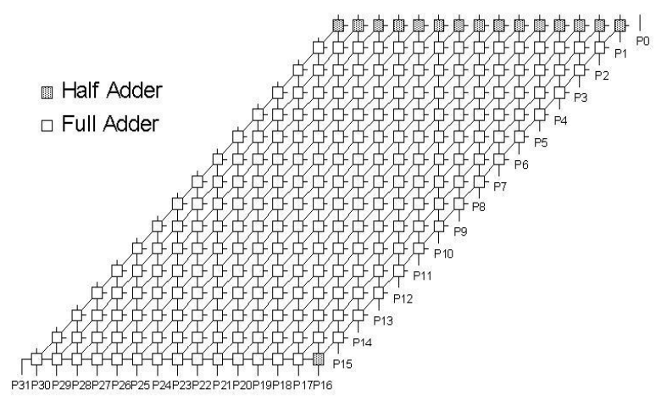
VACASK performance
C6288: 16x16 digital multiplier
Compute 0xFFFF x 0xFFFF
PSP103.4 MOSFETs
10112 transistors, 25380 unknowns
Default VACASK settings,
higher precision than SPICE
Disabled residual tolerance check,
precision roughly equal to that of SPICE
https://codeberg.org/arpadbuermen/VACASK/src/...
...branch/main/benchmark/c6288/vacask/runme.sim

Slide 14
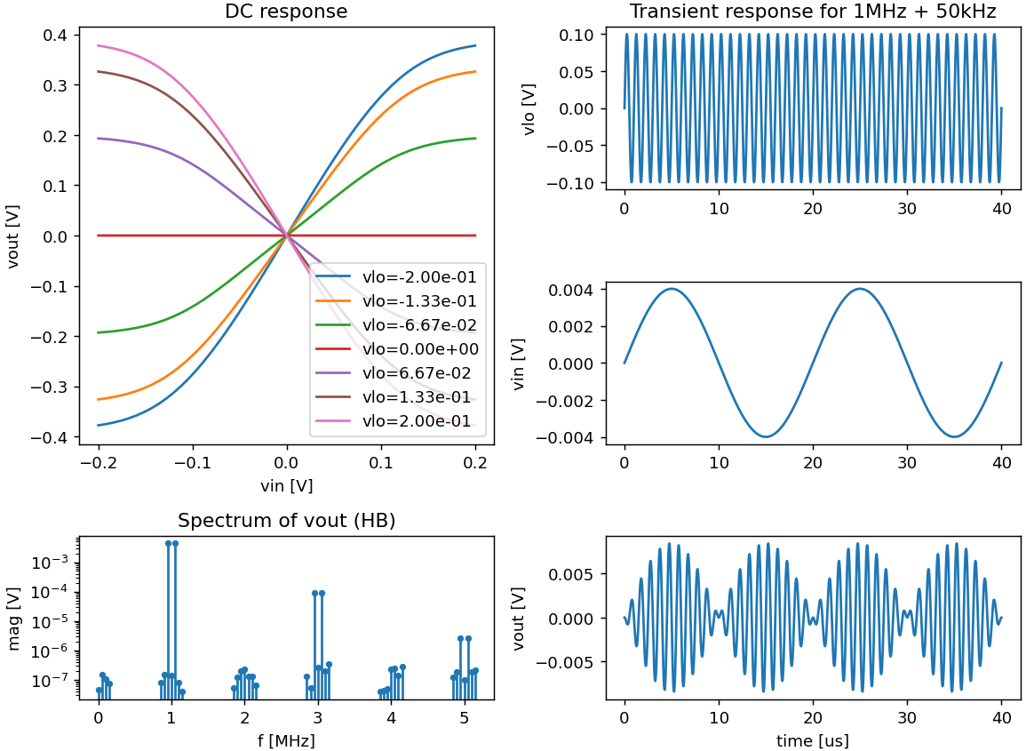
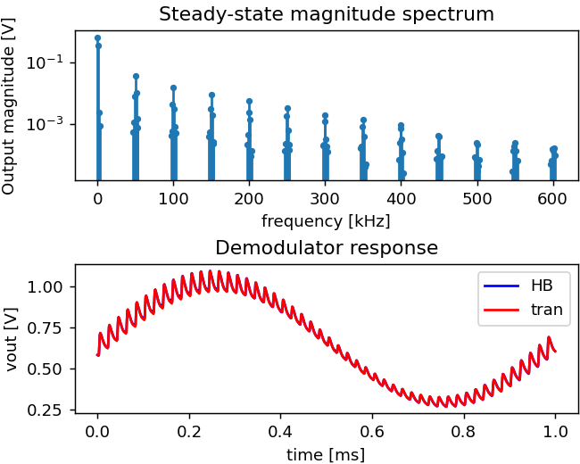
VACASK – harmonic balance
Diode AM demodulator, diode + R + C
2 tone HB, 3 sidebands, incommensurate
50kHz carrier, 1.01kHz signal
Gilbert cell mixer, 6 PSP103.4, 3 resistors
2 tone HB, 3 sidebands, commensurate
https://codeberg.org/arpadbuermen/VACASK/...
...src/branch/main/test/test_hb5.sim
https://codeberg.org/arpadbuermen/VACASK/...
...src/branch/main/demo/gilbert/gilbert.sim

Slide 15
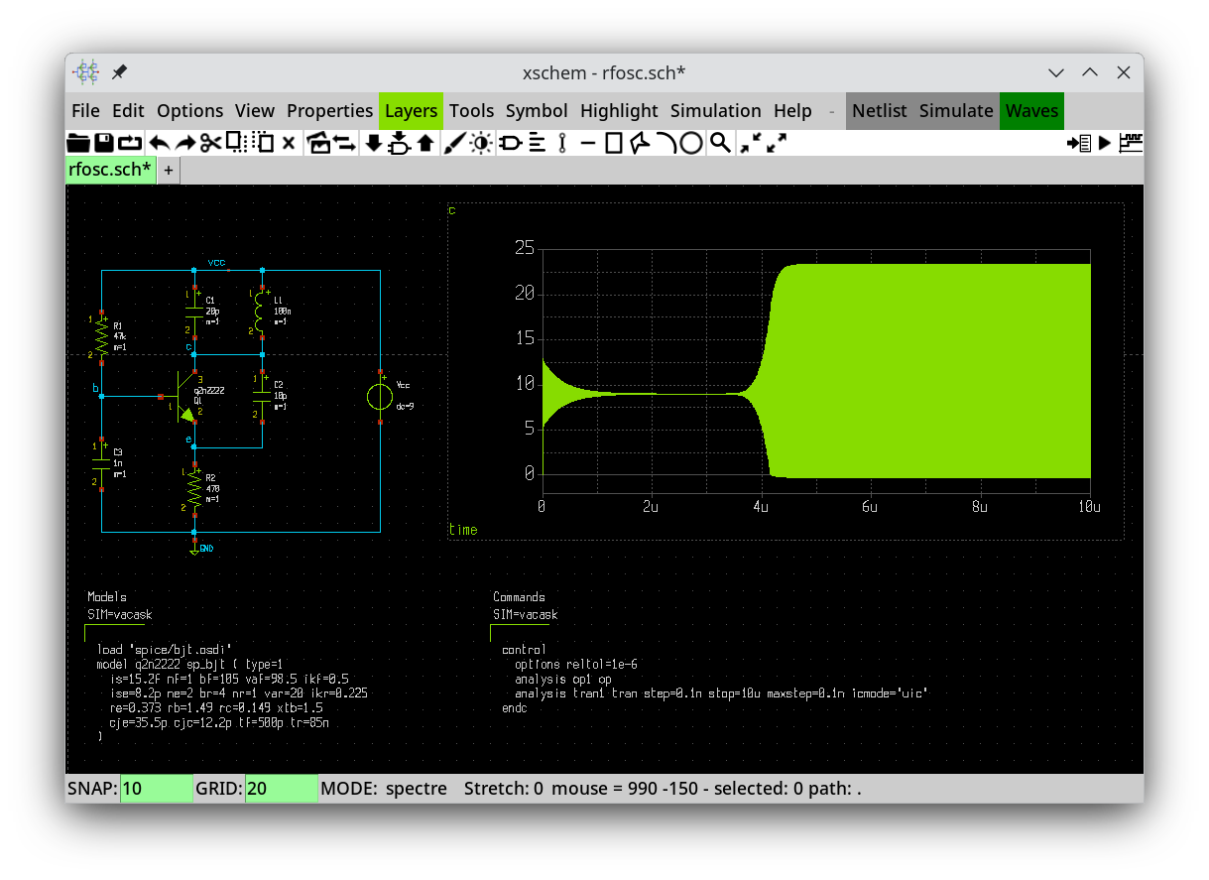
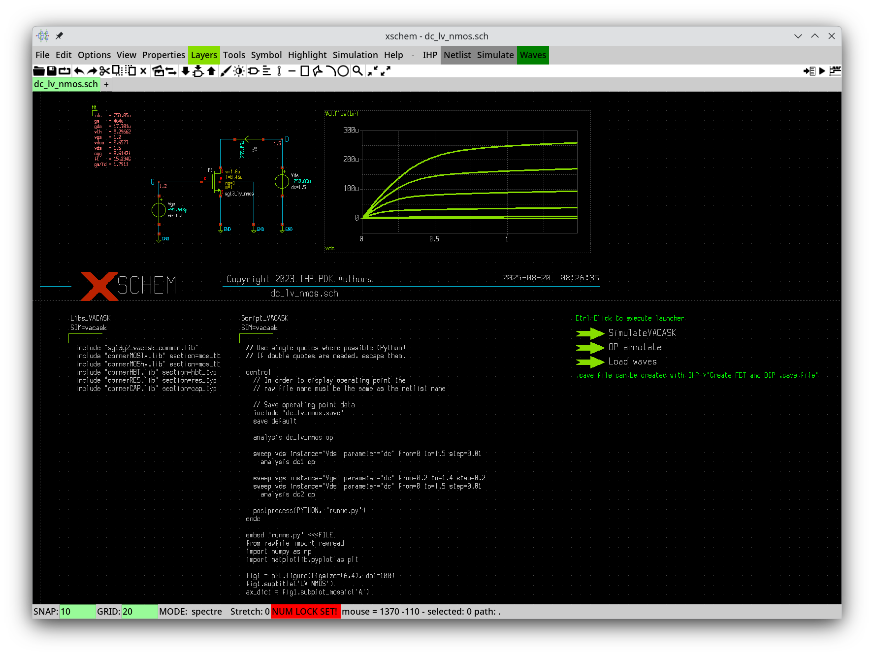
VACASK – Xschem and IHP PDK integration
Big thanks to
  Stefan Schippers for implementing the VACASK interface in Xschem
  Harald Pretl for sparking the idea of a Ngspice netlist converter

Slide 16

VACASK roadmap
Convert Skywater PDK.
Faster NOISE and XF analyses (adjunct circuit equations).
Stability analysis (STAB) and S-parameter analysis (SP).
Transient noise analysis.
Parallel evaluation (OpenMP).
Parallel linear solver (SUPERLU, MUMPS).
Shooting (PSS) & small-signal family
(PAC, PXF, PNOISE, PSP, PSTAB).
Improve harmonic balance, use FFTW library.
HB periodic small-signal family
(HBAC, HBXF, HBNOISE, HBSP, HBSTAB).
Convolutional linear models (touchstone).

Slide 17
Legacy models
SPICE3 models written in C, most of them not available in Verilog-A.
Still used!
  TSMC18 uses Gummel-Poon BJT, BSIM3v3.
  Many PDKs use SPICE diode.
  Discrete devices use MOS3, Gummel-Poon, JFET1, SPICE diode, ...
Educational value
Options
  Rewrite SPICE3 models in C/C++ for target simulator – a lot of work.
  Wrap SPICE3 models – cannot use them in advanced analyses (HB).
  Convert to Verilog-A – solve the problem once and for all.
Why convert?
  Implement once for all simulators, avoid bugs (in derivatives, …).
  Simplify implementation of new analyses.
Not available in Verilog-A: BSIM3, BSIM4, BSIM3SOI, BSIMSOI.

Slide 18

Verilog-A Distiller
Funded by NLNET NGI ZERO.
Semi-automatic converter.
Must clean up code before conversion (mostly on AST level).
Written in Python3, uses pycparser library.
Converts Ngspice pre-master-45 models.
Can track developments in Ngspice models.
Generated Verilog-A models are validated.
Models work in Ngspice and VACASK simulators.
Should also work in others.
12k lines of Python code, 10k lines of config.
51k lines of C → 18k lines of Verilog-A.
https://codeberg.org/arpadbuermen/VADistiller

Slide 19
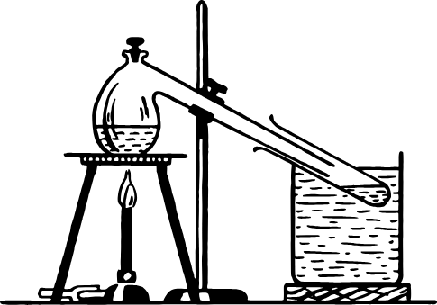
Verilog-A Distiller status
Converter almost finished.
Converted and validated:
  Passives: R, C, L
  SPICE diode (L1, L3)
  Gummel-Poon BJT
  JFET (L1, L2)
  MESFET L1
  MOSFET (L1-3, L6, L9)
  BSIM3
Working on BSIM4.

Slide 20
Converted models – code size
Element | C lines | Verilog-A lines | Reduction (x)
Resistor | 1201 | 329 | 3.7
Capacitor | 974 | 306 | 3.2
Inductor | 1068 | 285 | 3.7
Diode | 2891 | 1002 | 2.9
BJT | 4607 | 1458 | 3.2
JFET 1 | 2004 | 728 | 2.8
JFET 2 | 1864 | 983 | 1.9
MESFET 1 | 1670 | 617 | 2.7
MOS 1 | 4217 | 1275 | 3.3
MOS 3 | 4732 | 1613 | 2.9
BSIM3.3.0 | 12478 | 4211 | 3.0

Slide 21
Converted models – data structure size
Element | SPICE3 |  | Verilog-A + OpenVAF |  | Change wrt. SPICE3 [%]
 | Model | Instance | Model | Instance | Model | Instance
Resistor | 176 | 320 | 232 | 280 | 32 | -13
Capacitor | 160 | 208 | 200 | 216 | 25 | 4
Inductor | 128 | 240 | 144 | 216 | 13 | -10
Diode | 568 | 800 | 592 | 680 | 4 | -15
BJT | 1128 | 1712 | 1048 | 2096 | -7 | 22
JFET 1 | 280 | 720 | 224 | 904 | -20 | 26
JFET 2 | 408 | 728 | 360 | 1480 | -12 | 103
MESFET 1 | 224 | 680 | 136 | 840 | -39 | 24
MOS 1 | 320 | 1240 | 360 | 1824 | 13 | 47
MOS 3 | 424 | 1240 | 440 | 1984 | 4 | 60
BSIM3.3.0 | 3600 | 1304+968 | 3512 | 2472 | -2 | 9
PSP103.4 | - | - | 6320 | 6904 | - | -

Slide 22
Converted SPICE3 models - speed (1/2)
Evaluation bypass disabled, no OpenMP, use KLU linear solver.
Verilog-A cases - if possible, use Verilog-A models.
  Multiplier (4x diode, 4x capacitor, 1x resistor, 1x vsrc)
  Ring oscillator (5x JFET1, 10x capacitor, 15x resistor, 1x vsrc)
  Ring oscillator (9x BJT, 9x capacitor, 18x resistor, 1x vsrc, 1x isrc)
  C6288 (10112x converted BSIM3 - no NQS, 32x resistor, 33x vsrc)
  C6288 (10112x Cogenda BSIM3 - no NQS, 32x resistor, 33x vsrc)
Measure
  total runtime (per iteration),
  eval&load time (per iteration).
Use Ngspice & VACASK simulators.
Compare converted BSIM3 with Cogenda BSIM3 Verilog-A model.

Slide 23
Converted SPICE3 models - speed (2/2)
 | NR iteration time [us] |  |  | Eval&load time [us]
 | Ngspice |  | VACASK | Ngspice |  | VACASK
Circuit | Native | Verilog-A | Verilog-A | Native | Verilog-A | Verilog-A
Diode multiplier | 1.160 | 1.611 | 1.103 | 0.291 | 0.619 | 0.505
JFET1 ring oscillator | 1.750 | 2.586 | 2.199 | 0.413 | 1.072 | 0.906
BJT ring oscillator | 3.328 | 6.016 | 4.749 | 1.117 | 2.749 | 2.593
C6288 BSIM3 | 6580 | 12180 | 11950 | 4180 | 9650 | 10270
C6288 BSIM3 Cogenda | x | 8690 | 8730 | x | 7300 | 8020
VACASK Verilog-A interface is faster than that of Ngspice.
Converted models are roughly 2x slower than native models.
There is room for improvement in OpenVAF and VA Distiller.

Slide 24
Thank you!

